Slide 1
Welcome To My Presentation

Slide 2
Presented by
Mojammel Haque Bhuiyan
ID: CE20055
Session: 2019-20
Department of CSE, MBSTU

Slide 3
Presentation on
Catch The Ball

Slide 4
Supervised By:
Shisir Mia
Assistant Professor
Department of CSE, MBSTU

Slide 5
Course Title :
Software Development Project-I and Industrial Tour
Course Code : CSE-2112

Slide 6
Introduction
In this game there will be one player . User is the player of the game.
Using arrow keys (left and right) player can be moved.
Using keyboard user can exit from the game in the middle of the game and also play again (after game over) and exit from the game.

Slide 7
Objective
The aim of this project is to develop a graphics package which supports basic operations which include building a 2D game using Code::Blocks 20.03 .
The objective of developing this model was to design and apply the skill we learnt .

Slide 8
Methodology
To implement the above “2D Game ”, the following methodology needs to be followed:
Declaration of the function GameBody( ) to draw Rectangle , Colored Circle , Line etc.
Applying the movement function on player [moveLine( ) ] and ball [ moveBall() ]
Collision detection between line – ball . After detection score updated accordingly . And the Level will update according to the score. And chance also updated.

Slide 9
System Specification:
Hardware Requirements:
Keyboard
Software Requirements:
Programming language – C
Operating system – Windows
Compiler – GNU GCC and TDM-GCC-32 compiler
Graphics library – graphics.h

Slide 10
Works Done
In “ Catch The Ball ” 2D game different state are created which defines the Game-state.
Start Game
Level, Chance and Score live update
Exit game
Game over
Game End
Show score
Play again or Exit

Slide 11
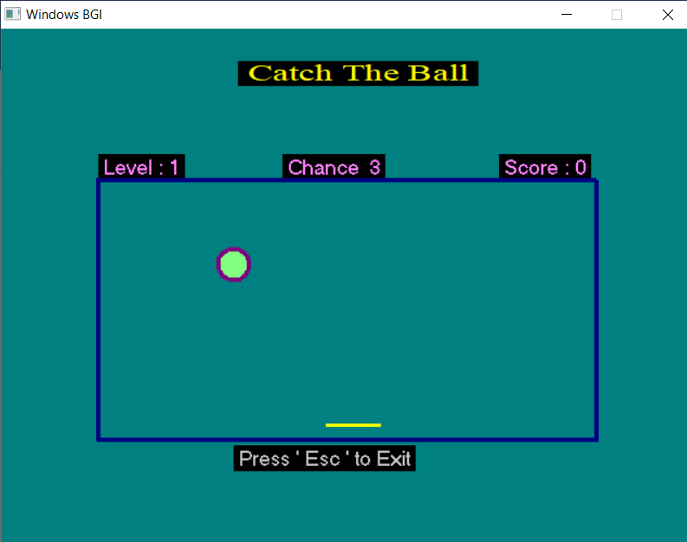
Game Start :
This is the first screen of the game. In this state user can play or exit the game using keyboard .
Initially
Level is 1
Given chance is 3
Score is 0
Player can Exit by pressing ‘ Esc ’ key

Slide 12
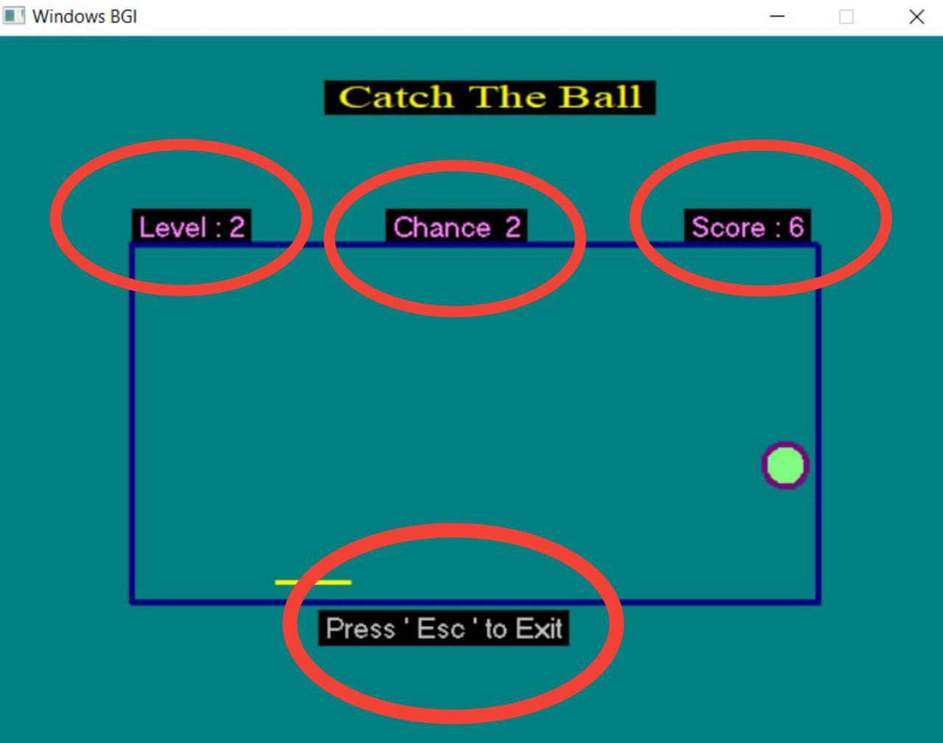
If score is greater then or equal to 5 the level updated to level 2 and If chance is zero then game end.

Slide 13
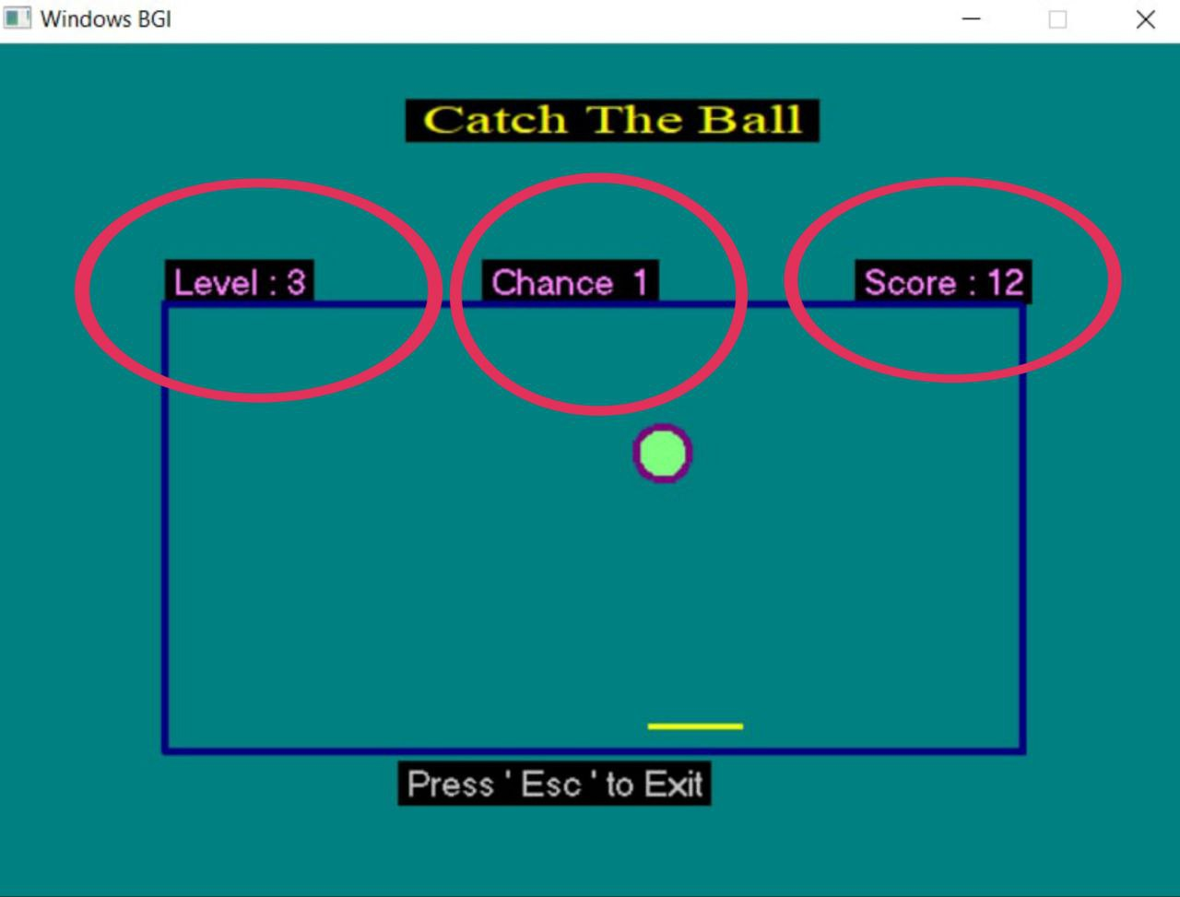
If score is greater then or equal to 10
the level updated to level 3 and
If chance is zero then game end.

Slide 14
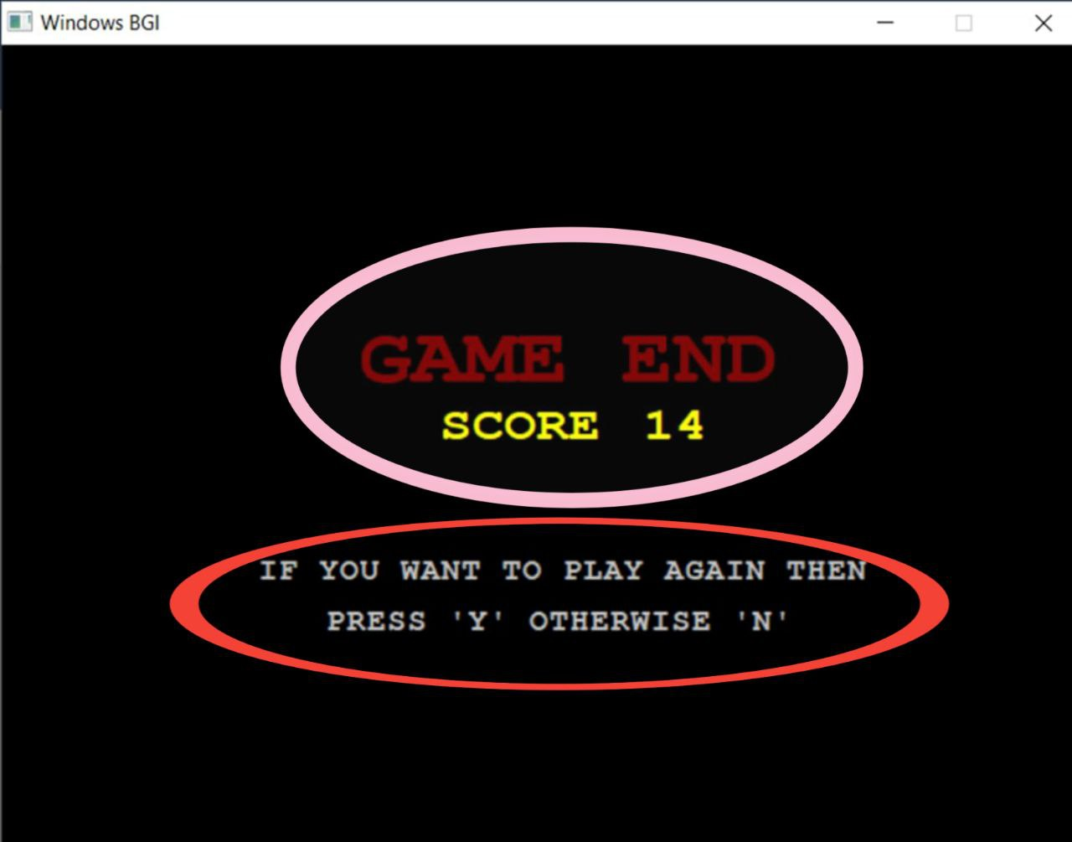
Score show after game end .
And if player want to play again he has to press Y/y otherwise press N/n .

Slide 15
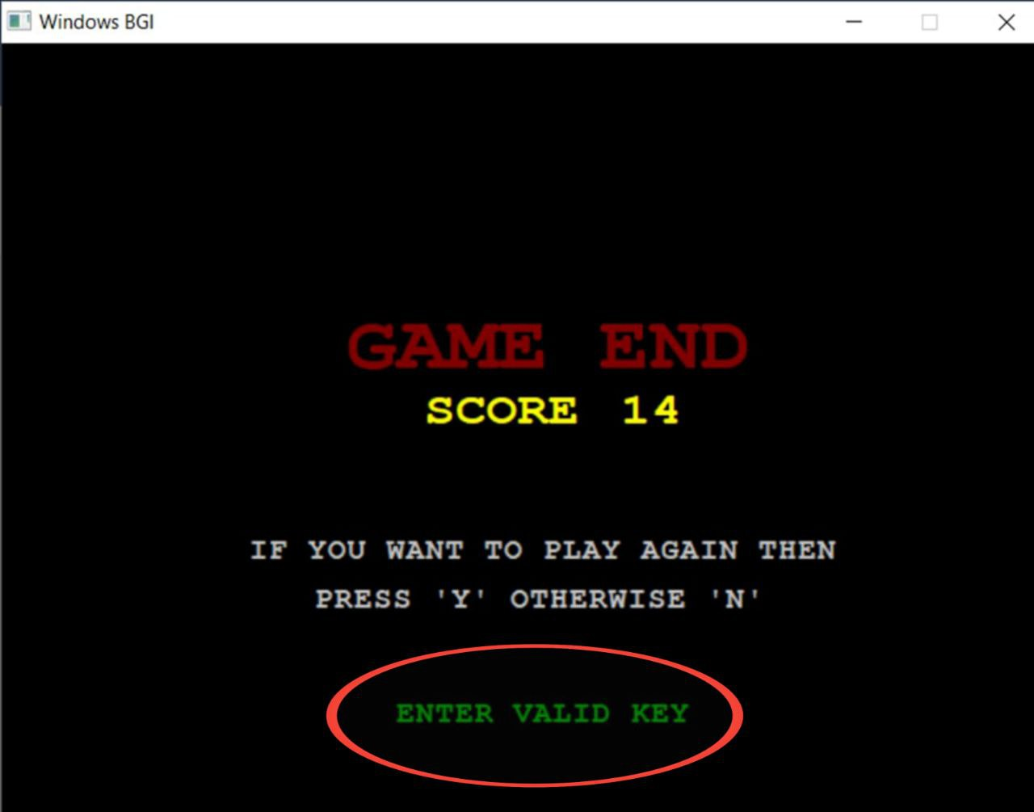
If the player press any invalid key there shows a message “ ENTER VALID KEY ”.

Slide 16
Limitations:
Mouse input not handled.
No way to know high score.
No online connectivity.

Slide 17
Conclusion
It has an open source and no security features has been included.
The user is free to alter the code for feature enhancement.
Bugs may be reported to creator as the need.

Slide 18
Thank You

